Slide 1
Evaluation of Object Oriented Programming (OOP)

Slide 2

Contents
The study of programming languages
Introduction to programming paradigm
Programming Language types
  Unstructured programming languages
  Procedural programming languages
  Structured programming languages
  Object Oriented programming (OOP) languages
Building blocks of OOP
Why OOP?
Features of OOP
References
Next lecture topics

Slide 3
The study of programming languages
The purpose of language is simply that it must convey meaning.
Whatever can be said, can be said clearly.
A programming language is a notation for writing programs.
  A computer program is a collection of instructions that can be executed by a computer to perform a specific task. A computer program is usually written by a computer programmer in a programming language.

Slide 4
Introduction of paradigm and programming paradigms
Paradigm can also be termed as method to solve some problem or do some task.
Programming paradigm is an approach to solve problem using some programming language.
Also we can say it is a method to solve a problem using tools and techniques that are available.

Slide 5
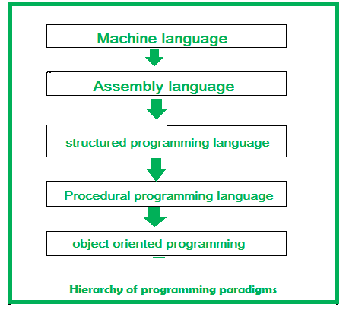
Introduction of paradigm and programming paradigms
There are lots for programming language that are known but all of them need to follow some strategy when they are implemented and this methodology/strategy is paradigms.

Slide 6
Programming Languages
Machine language
Unstructured programming languages
Procedural programming languages
Structured oriented programming languages
Object oriented programming languages
Machine
Language
Unstructured programming languages
e.g. assembly
Procedural programming languages
e.g. FORTRAN, COBOL
Structured programming languages
e.g. C and PASCAL
Object oriented programming languages
e.g. C++ JAVA

Slide 7
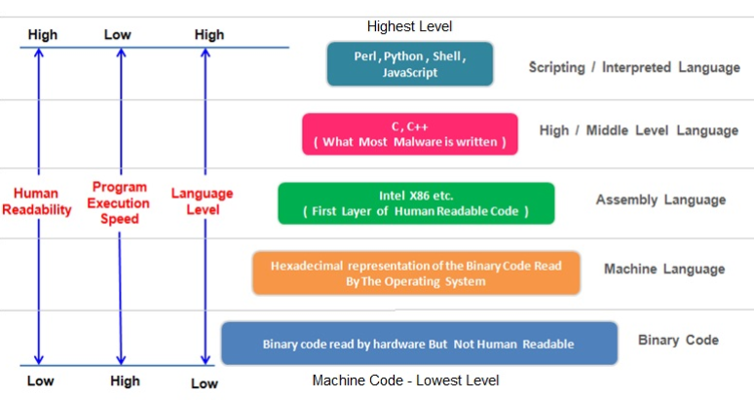
Overview of programming language types and levels

Slide 8
Machine language
Machine language is the language understood by a computer.
Very difficult to understand, but it is the only thing that the computer can work with.
All programs and programming languages eventually generate or run programs in machine language.

Slide 9
Machine language
Machine code, consisting of machine language instructions, is a low-level programming language used to directly control a computer's central processing unit (CPU).
Machine language can only be represented by 0s and 1s.

Slide 10
Assembly language
Assembly language is the more than low level and less than high-level language so it is intermediary language.
Assembly languages use numbers, symbols, and abbreviations instead of 0s and 1s.

Slide 11
Machine language vs Assembly language
Machine Language | Assembly Language
Machine language is only understand by the computers. | Assembly language is only understand by human beings not by the computers.
In machine language data only represented with the help of binary format(0s and 1s), hexadecimal and octadecimal. | In assembly language data can be represented with the help of mnemonics such as Mov, Add, Sub, End etc.
Machine language is very difficult to understand by the human beings. | Assembly language is easy to understand by the human being as compare to machine language.
Modifications and error fixing cannot be done in machine language. | Modifications and error fixing can be done in assembly language.
Machine language is very difficult to memorize so it is not possible to learn the machine language. | Easy to memorize the assembly language because some alphabets and mnemonics are used.
Execution is fast in machine language because all data is already present in binary format. | Execution is slow as compared to machine language.
There is no need of translator.The machine understandable form is the machine language. | Assembler is used as translator to convert mnemonics into machine understandable form.
Machine language is hardware dependent. | Assembly language is the machine dependent and it is not portable.

Slide 12
Unstructured programming languages
Entire logic of the program is written as a single continuous (nonstop or unbroken) block is called "unstructured Programming".
Consists of just writing the sequence of commands or statements in the main program.
Program written by following this language is very difficult to modify and to debug.
Example, assembly language programs.

Slide 13
Unstructured programming languages
Limitations
Data is global and code operate on it.
The concept of local variable did not exist.
Does not have independent data for processing.
As the code increases, maintenance become more complex.
Reusability of code not supported.

Slide 14
Procedural programming languages
The first programming paradigm that a new developer will learn.
Fundamentally, the procedural code is the one that directly instructs a device on how to finish a task in logical steps.
This paradigm uses a linear top-down approach and treats data and procedures as two different entities.
Example FORTRAN and COBOL language programs.

Slide 15
Procedural programming languages
Procedural programming divides the program into procedures, which are also known as routines or functions, simply containing a series of steps to be carried out.
It involves writing down a list of instructions to tell the computer what it should do step-by-step to finish the task at hand.
Program flow control is achieved through function calls and goto statements.

Slide 16
Procedural oriented programming languages
The program code is harder to write.
The procedural code is often not reusable, need to recreate.
Difficult to relate with real-world objects.
The importance is given to the operation rather than the data, which might pose issues in some data-sensitive cases.
Data is not secured because data is global and can be accessed by any function.
Limitations

Slide 17
Structured programming languages
Large programs are divided into small programs called functions, modules, subprogram, subroutines and procedures.
Modular programming is another name for this.
These functions have statements embraced inside curly braces. Each function is design to do a specific task with its own data and logic.
Data moves freely around the systems from one function to another.

Slide 18
Structured programming languages
Information can be passed from one function to another function through parameters.
A function can have local data that cannot be accessed outside the function’s scope.
Easier for the programmer to test and debug the code
Program structure follows “Top Down Approach”. Example: C, Pascal, ALGOL and Modula-2

Slide 19
Structured oriented programming languages
Limitations
Data hiding
Debugging of program is hard
  Not possible to handle run time errors and future enhancements
Software development period and cost is high
If end user require changes, a big modification is needed in software
More stress laid on procedures not on data

Slide 20
Object oriented programming languages
OOP is a fundamental programming paradigm
In this type of language, programs are divided into objects.
Prime focus is on the data that is being operated and not on the functions or procedures.
Data is hidden and cannot be accessed by external functions.
Program structure follows “Bottom UP Approach”.

Slide 21
Object oriented programming languages
The focus of OOP languages is not on structure, but on modeling data.
The main aim of OOP is to bind together the data and the functions that operate on them so that no other part of the code can access this data except that function.

Slide 22
Object oriented programming languages
OOP is a programming paradigm that relies on the concept of classes and objects.
It is used to structure a software program into simple, reusable pieces of code blueprints (usually called classes) which are used to create individual instances of objects.

Slide 23
Object oriented programming languages
A programmer designs a software program by organizing related pieces of information and behaviors together into a template called a class
The entire software program runs by having multiple objects interact with objects to create the larger program
Examples of OOP languages include C++, Visual Basic.NET and Java.

Slide 24
Comparison
Procedure/Structure oriented | Object oriented
Top-down. | Bottom-up.
Main focus is on "how to get the task done" i.e. on the procedure or structure of a program . | Main focus is on 'data security'. Hence, only objects are permitted to access the entities of a class.
Large program is divided into units called functions. | Entire program is divided into objects.
No access specifier observed. | Access specifier are "public", "private", "protected".
Neither it overload functions nor operators. | It overloads functions, constructors, and operators.

Slide 25
Comparison
Procedure/Structure oriented | Object oriented
Their is no provision of inheritance. | Inheritance achieved in three modes public private and protected.
There is no proper way of hiding the data, so data is insecure | Data is hidden in three modes public, private, and protected. hence data security increases.
Global data is shared among the functions in the program. | Data is shared among the objects through the member functions.
No concept of friend function. | Classes or function can become a friend of another class with the keyword "friend". Note: "friend" keyword is used only in c++
No concept of virtual classes . | Concept of virtual function appear during inheritance.

Slide 26
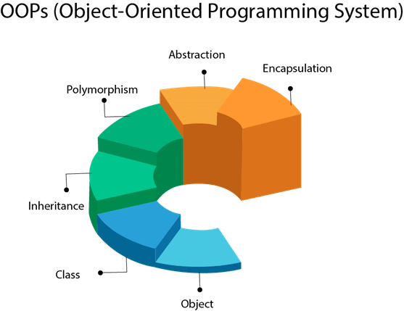
Building blocks of OOP
The code building blocks to build an OOP program are:
Classes (Blue print/prototype)
  A class is a user defined blueprint or prototype from which objects are created. It represents the set of properties or methods that are common to all objects of one type.

Slide 27
Building blocks of OOP
Methods (Behavior / actions)
Are function that manipulate the data, an action performed by an object (a verb)
Attributes
(instance variable / information / property / characteristic / field and state) are the attributes of the object, - Characteristics of certain object.

Slide 28
Building blocks of OOP
Objects (Instance of class)
Usually a person, place or thing (a noun). An object is an instance of class. objects stores data and provides method for accessing and modifying this data.
Object is considered to be partitioned area of compute memory that stores data and a set of operations that can access the data

Slide 29
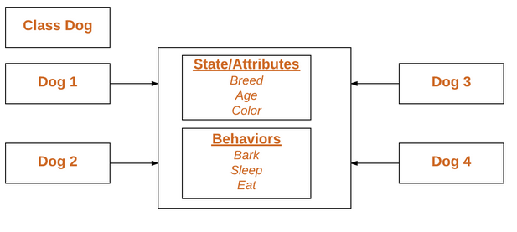
Example
Objects

Slide 30
Why OOP?
OOP is an approach that provides a way of modularizing programs by creating partitioned memory area for both data and functions that can be used as templates for creating copies of such modules on demand.
OOP makes code organized, reusable, and easy to maintain. It follows the DRY (Don’t Repeat Yourself) principle used by many programmers to make efficient programs

Slide 31
Why OOP?
OOP also prevents unwanted access to data, or exposing proprietary code through encapsulation and abstraction. Both are discussed later
So how do programmers create Object Oriented programs? Well the short answer is by making classes, and creating objects from the classes. Classes form the blueprint for how data & behaviors are structured.

Slide 32
Why OOP?
Objects are created for specific instances of a class. As a programmer, you might create a dog class (blueprint) as a standard way to organize all the important information about dogs, and then instantiate an individual dog as an object created from the dog class - like your dog xyz.

Slide 33
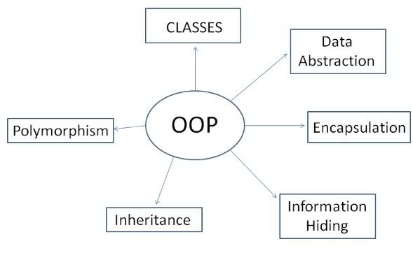
Features of OOP

Slide 34
References
https://www.javatpoint.com/java-tutorial
https://www.geeksforgeeks.org/classes-objects-java/
https://techdifferences.com/difference-between-oop-and-pop.html
https://www.educative.io/blog/object-oriented-programming
https://www.geeksforgeeks.org/difference-between-machine-language-and-assembly-language/
https://www.learncomputerscienceonline.com/computer-programming/#POST2anchor2
https://www.geeksforgeeks.org/introduction-of-programming-paradigms/

Slide 35
THANK YOU

Slide 36
Next
Introduction to Java, NetBeans IDE, basic program, syntax, first program with use of class, object, attribute and method

